Slide 1
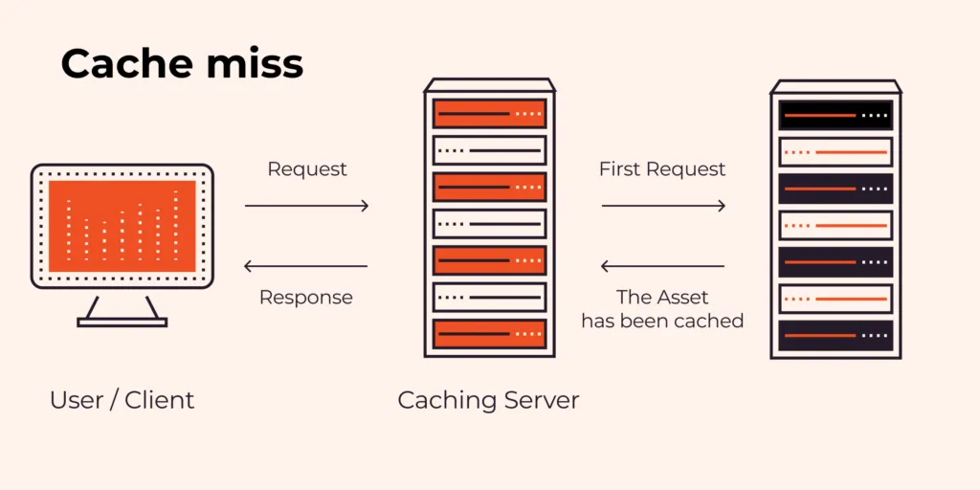
Caching
Understanding the Basics of Caching

Slide 2
What is Caching?
Caching is a technique to store frequently accessed data in a temporary storage to improve performance.

Slide 3
Why Use Caching?
1. Improves performance
2. Reduces database load
3. Enhances user experience
4. Saves bandwidth
1. Improves performance
2. Reduces database load
3. Enhances user experience
4. Saves bandwidth

Slide 4
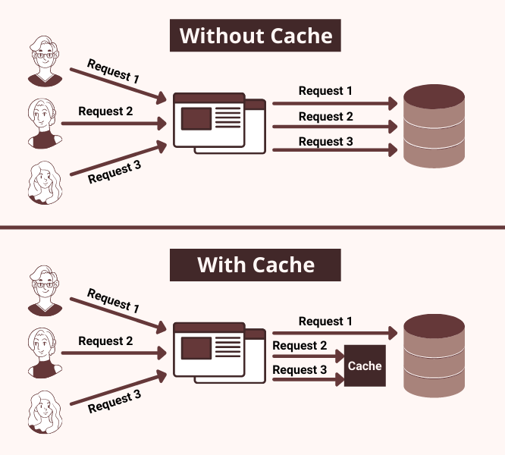
Why Use Caching?

Slide 5
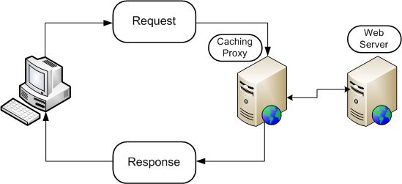
How Caching Works
1. Request is made
2. Check cache for data
3. If found, return cached data
4. If not, fetch from source and store in cache

Slide 6
Types of Caching
1. Client-Side Caching
2. Server-Side Caching
3. Distributed Caching
4. Application Caching

Slide 7
Client-Side Caching
Examples:
- Browser caching
- CDN caching

Slide 8
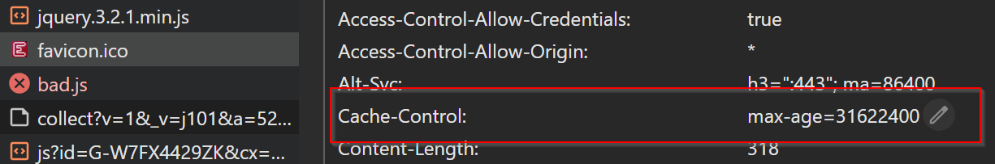
Client-side Caching (Browser caching)
Browser caching is a technique that allows web browsers to store copies of web pages, images, and other online content locally on your device.
When you visit a website, your browser downloads all the necessary files—like HTML, CSS, JavaScript, and media—to display the page.
Instead of downloading everything from the server again on your next visit, the browser can load these stored (or "cached") files from your device.
When you first visit a site, the server tells your browser which files it can cache and for how long (via something called "cache-control headers"). If you revisit the site before that time expires, the browser uses the local copies instead of fetching them anew.

Slide 9
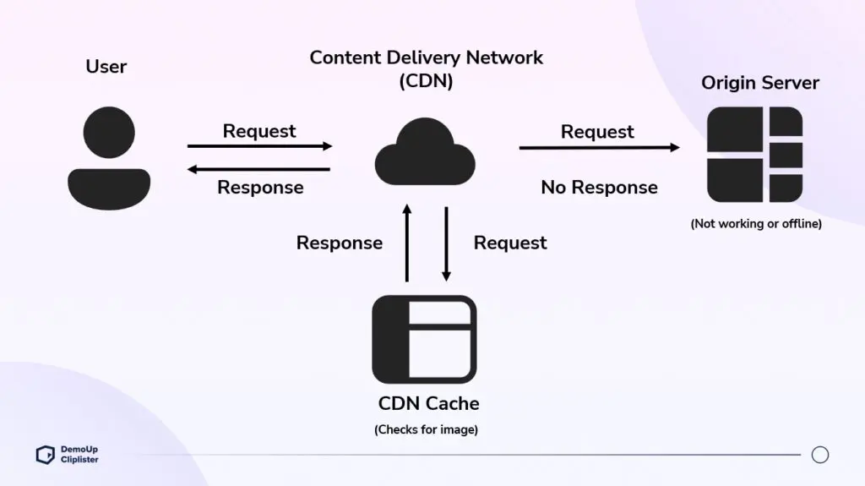
Client-side Caching (CDN caching)
CDN caching refers to the process of storing copies of web content, such as HTML pages, images, videos, or other files, on a Content Delivery Network (CDN).
A CDN is a distributed network of servers located in various geographic regions, designed to deliver content to users more quickly and efficiently
Key Benefits:
Faster Load Times: Content is served from a location closer to the user.
Reduced Server Load: The origin server handles fewer direct requests.
Improved Reliability: CDNs can handle traffic spikes and distribute load effectively.
Better User Experience: Quicker access to content improves satisfaction.

Slide 10
Server-Side Caching
Examples:
- Reverse proxy (e.g., Varnish, Nginx)
- Object caching (e.g., Redis, Memcached)

Slide 11
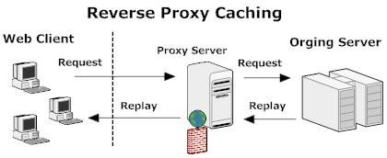
Server-Side Caching (Reverse proxy)
A reverse proxy is a type of server that sits between clients (like your web browser) and one or more backend servers (like web servers). Storing frequently requested content to speed up delivery.

Slide 12
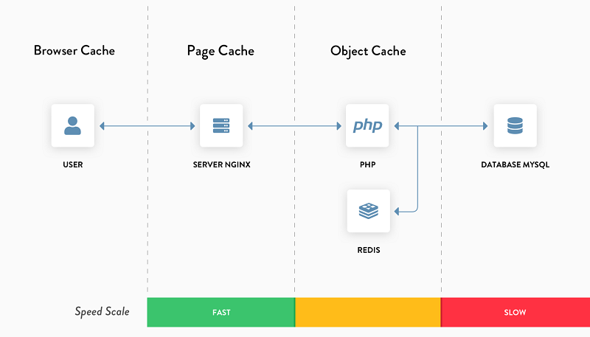
Server-Side Caching (Object caching)
Storing frequently accessed data objects—such as the results of database queries, API calls, or complex computations

Slide 13
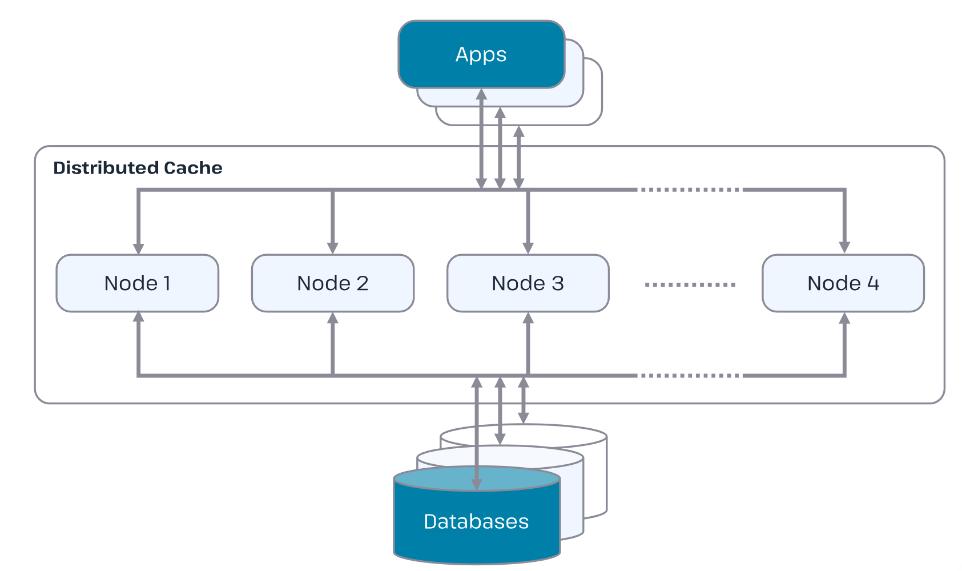
Distributed Caching
Used in large-scale applications to share cached data across multiple servers.

Slide 14
Distributed Caching
Profits (Benefits):
Improved Performance: By storing frequently accessed data closer to the application (e.g., in memory across nodes), distributed caching reduces latency and speeds up data retrieval compared to fetching from a primary database.
Scalability: It allows systems to handle increased load by adding more nodes to the cache cluster, distributing the workload efficiently.
High Availability: Data is replicated or partitioned across multiple nodes, so if one node fails, the system can still function, enhancing fault tolerance.
Reduced Database Load: Caching offloads queries from the primary database, preventing bottlenecks and improving overall system efficiency.
Geographic Distribution: For global applications, data can be cached in nodes closer to users, reducing network latency and improving user experience.
Drawbacks:
Complexity: Setting up and managing a distributed cache is more complex than a single-node cache.
Consistency Challenges: Ensuring data consistency across nodes can be tricky, especially in scenarios with frequent updates, leading to potential cache staleness or race conditions.
Cost: Maintaining multiple nodes, whether in hardware or cloud infrastructure, increases operational costs.
Cache Miss Overhead: If data isn’t found in the cache (cache miss), the system must fetch it from the source, and in a distributed setup, this can involve additional network latency or coordination.
Data Eviction Risks: With limited memory per node, less-used data may be evicted, potentially leading to more frequent misses if not properly tuned.

Slide 15
Cache Hit vs. Cache Miss
Cache Hit: Data found in cache
Cache Miss: Data not found, needs to be fetched

Slide 16
Cache Invalidation
Techniques:
- Time-based expiration
- Manual invalidation
- Event-based invalidation

Slide 17
Memory vs. Disk Caching
Memory Caching: Faster, uses RAM
Disk Caching: Slower, but persistent

Slide 18
Popular Caching Tools
1. Redis
2. Memcached
3. Varnish
4. CDN services (Cloudflare, Akamai)

Slide 19
Using Redis for Caching
Redis is an in-memory data store often used for caching.

Slide 20
Using Memcached for Caching
Memcached is a high-performance distributed memory object caching system.

Slide 21
CDN Caching
Content Delivery Networks (CDNs) cache static files to improve load times globally.

Slide 22
Database Query Caching
Databases cache query results to speed up repeated queries.

Slide 23
Page Caching
Stores full-page content to serve quickly without generating it dynamically.

Slide 24
Object Caching
Caches objects like API responses, computed results, and session data.

Slide 25
Challenges of Caching
1. Stale data(old data)
2. Cache invalidation complexity
3. Memory limitations

Slide 26
When Not to Use Caching
1. Highly dynamic data
2. Security-sensitive data
3. Limited memory resources

Slide 27
Real-World Use Cases
1. Web applications
2. APIs
3. AI/ML models

Slide 28
Best Practices for Caching
1. Choose the right caching strategy
2. Monitor cache usage
3. Set appropriate expiration times

Slide 29
Caching in Cloud Computing
Cloud providers offer managed caching solutions like AWS ElastiCache and Azure Cache for Redis.

Slide 30
Conclusion
Caching is a powerful technique to optimize application performance and user experience.

